Slide 1
Breast Cancer Classification
Using KNN model
-----5509 Final Project
Notes:
Hello everyone, today I’m going to share my final project for the supervised machine learning course. Basically, I used a KNN model to classify breast cancer.

Slide 2
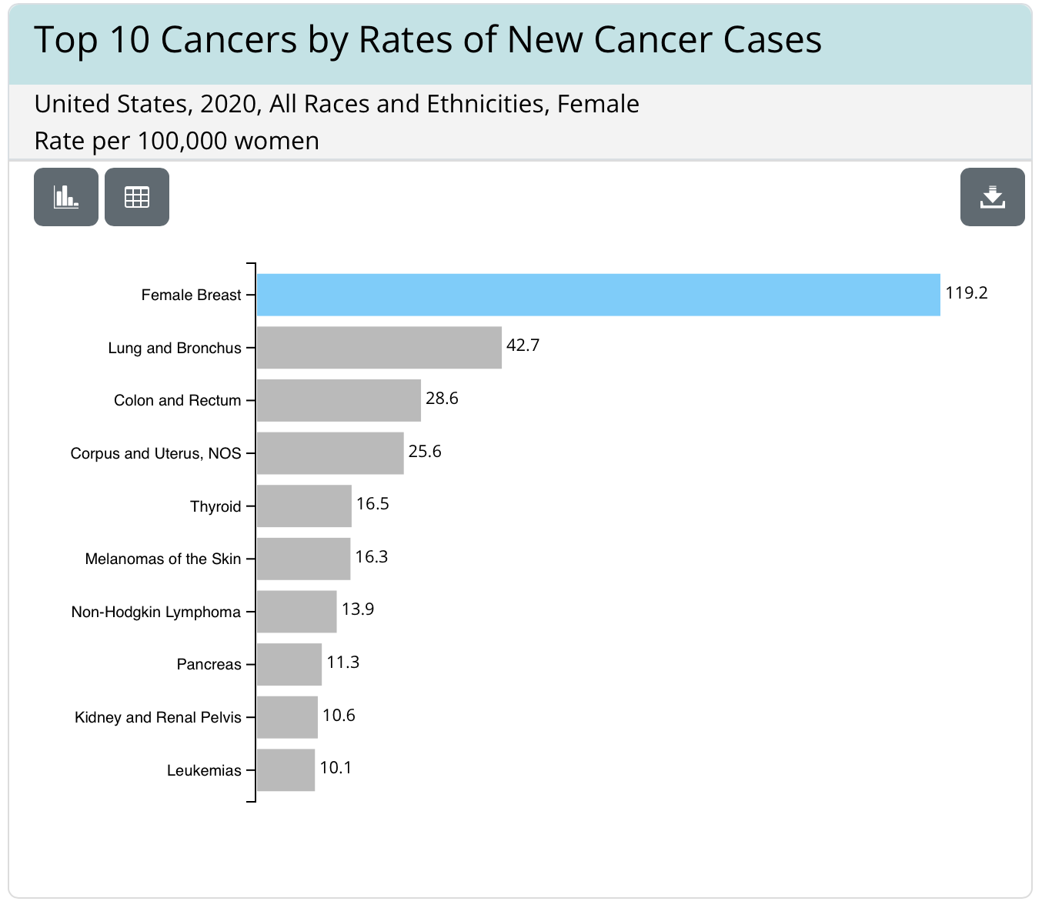
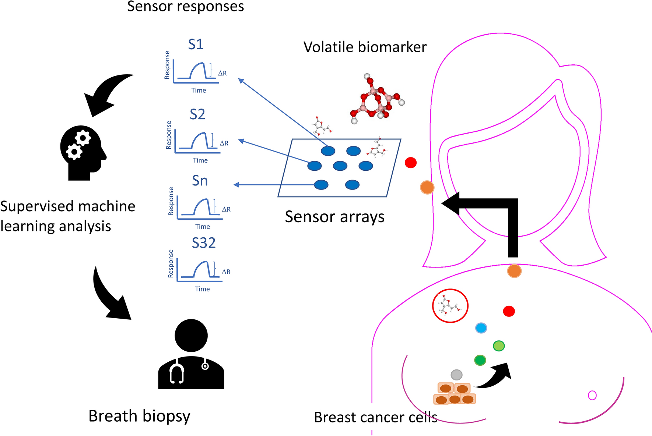
Introduction
Machine Learning classification emerges as an
important tool for breast cancer diagnosis
Breast cancer is widespread and serious
Notes:
To start with some background. We know that breast cancer is a serious disease, and it has the most number of new cases every year compared with other types of cancer as you can see from the graph on the left. So, it is important to develop tools to diagnose breast cancer.
These years, machine learning algorithms emerge as an important tool for breast cancer diagnosis. Basically, doctors will collect breast cancer cells, and measure different properties of these cells, like their size, shape, and gene expression levels. They next will feed the data to machine learning algorithm to build a classifier to help with future diagnosis.

Slide 3
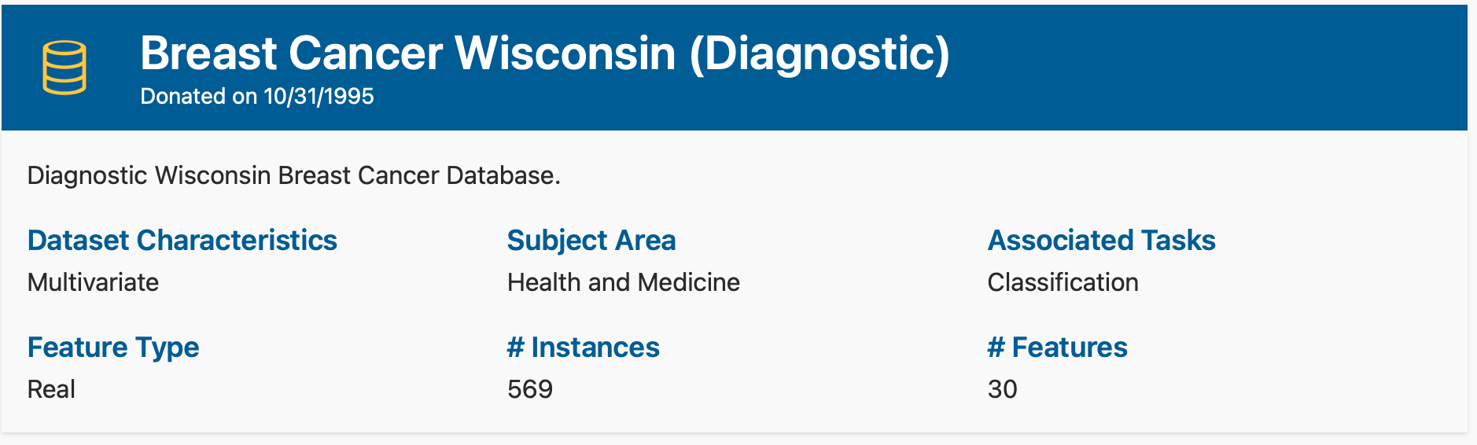
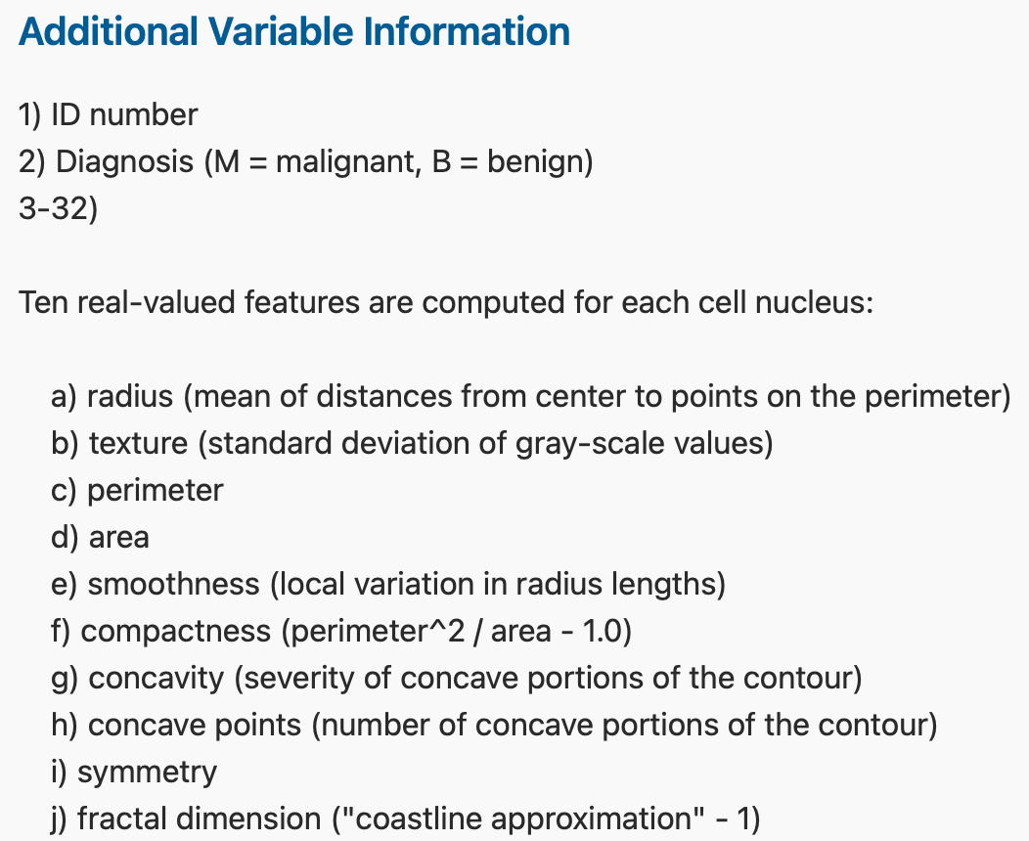

The Data
https://archive.ics.uci.edu/dataset/17/breast+cancer+wisconsin+diagnostic

Slide 4
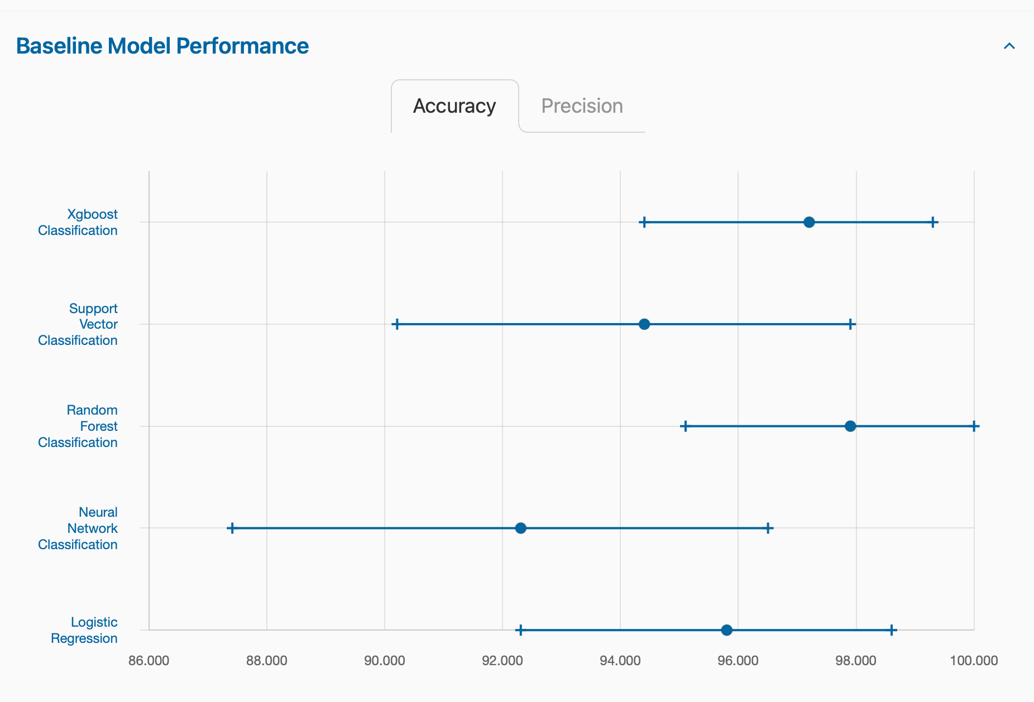
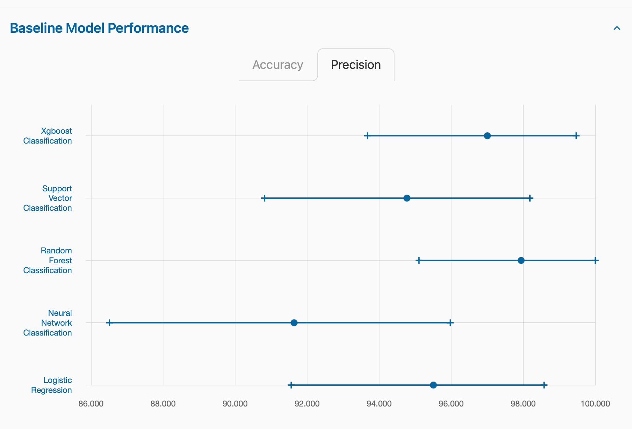
The Question
How is KNN model compared to these machine learning algorithms?

Slide 5
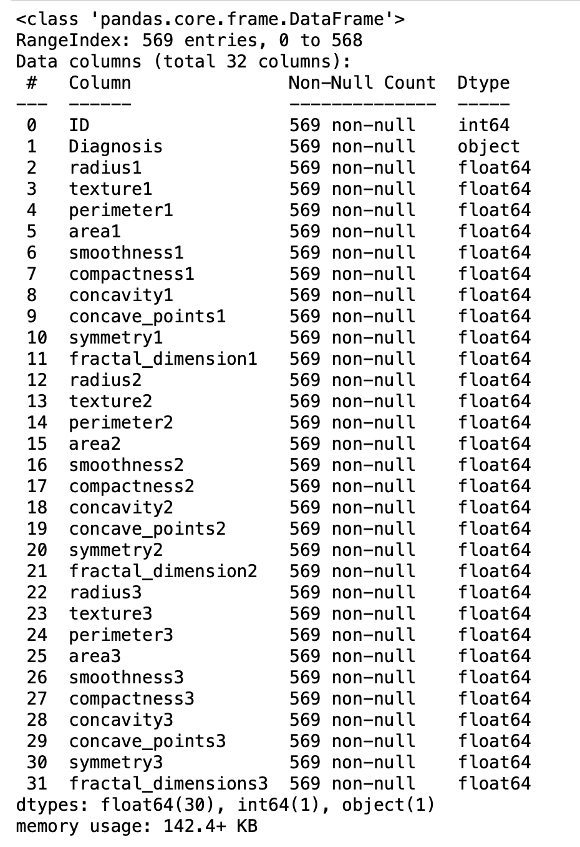
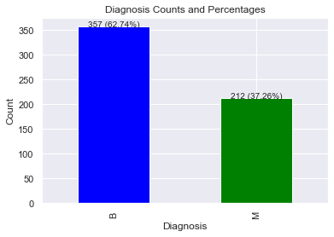
Data Information

Slide 6
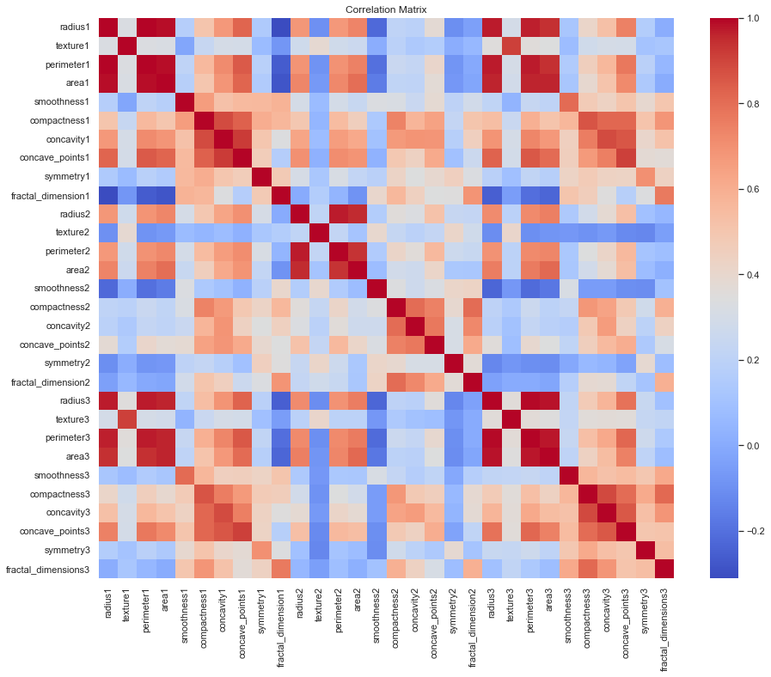
Feature Selection
Features removed due to high coefficient(> 0.9):
"perimeter1", "perimeter2", "perimeter3",
"radius1", "radius2", "radius3",
"texture3", "area3", "concave_points3"

Slide 7
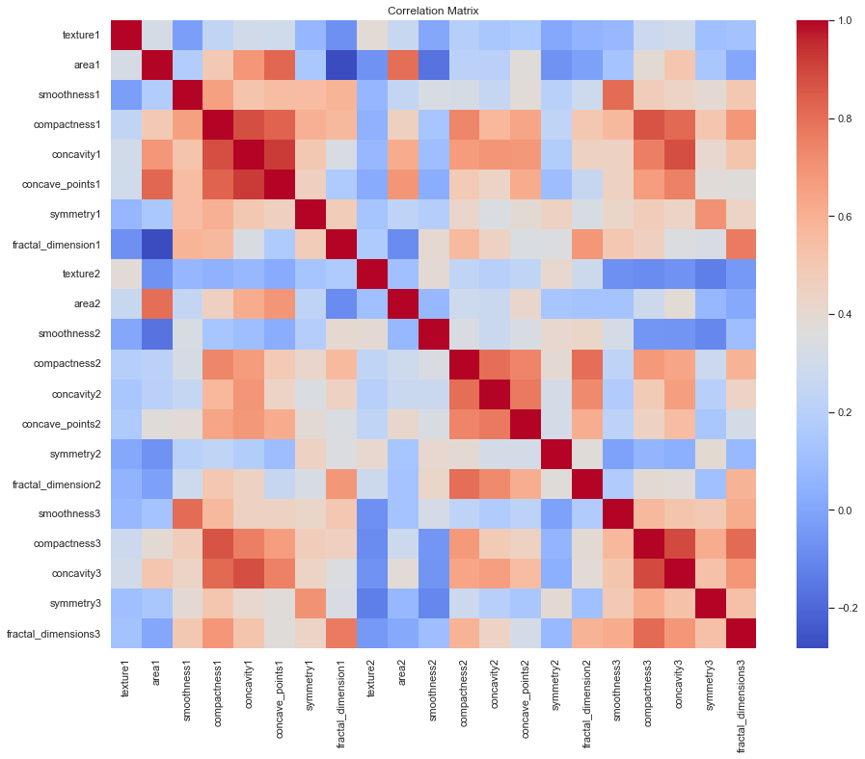
After Feature Selection
21 features in total

Slide 8
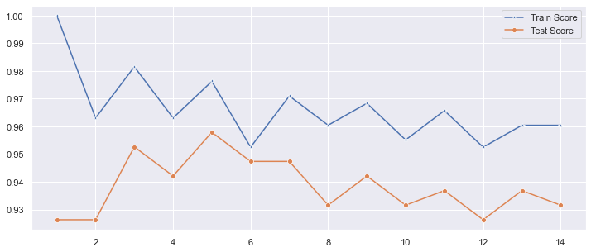
KNN Modeling
z-score normalization → split train and test data → find the best K value(K=5)

Slide 9
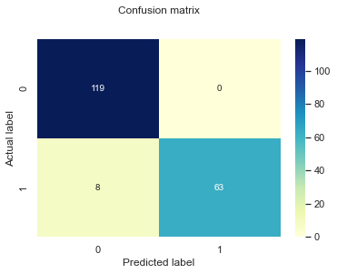
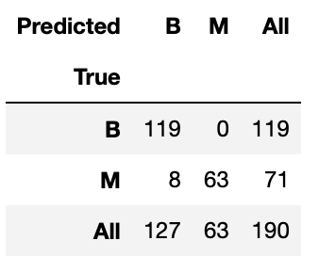
Model Evaluation

Slide 10
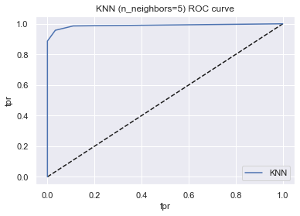

Model Evaluation

Slide 11
Conclusion

Slide 12
Summary
Things that need improvement:
Ways to improve:
The model's misclassification of malignant tumors as benign (8 out of 71 instances) has serious consequences in real-life scenarios.
Feature Relevance Ranking
Cross-Validation
Distance Metric Selection

